Slide 2
Workflow Enhancements in SharePoint 2010
Name
Title
Company

Slide 3
Agenda
What’s New in SharePoint 2010 Workflow
Creating Workflows in Visio 2010
Designing Workflows with SPD
Developing Workflows with VS 2010

Slide 4
"What's New" for SharePoint 2010
For the end-user
New targets to run a workflow
Visio visualization of running workflows
For the power-user
Improved designer and nested logic
Reusable declarative workflows
New Task Process designer
Customizable OOB workflows
No-Code InfoPath Forms
Visio Workflows
For the developer
Visual Studio 2010 SharePoint tools
Workflow Events
Pluggable External Data Exchange Services
Workflows in SharePoint 2010 run as .Net 3.5 Workflows – no support for .Net 4.0

Slide 5



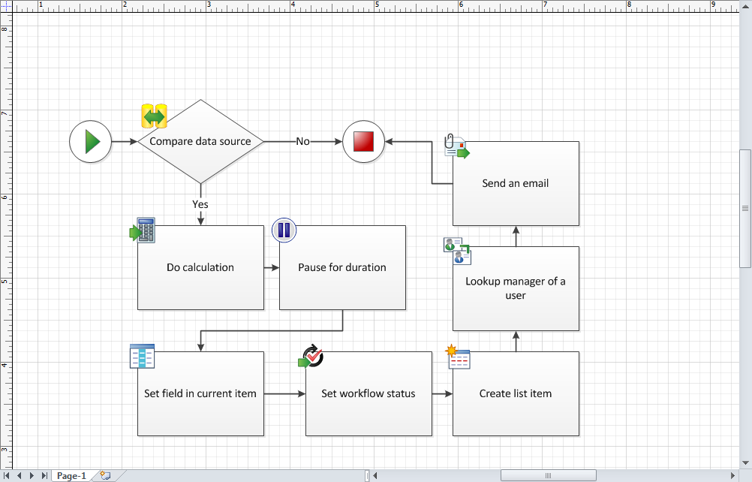
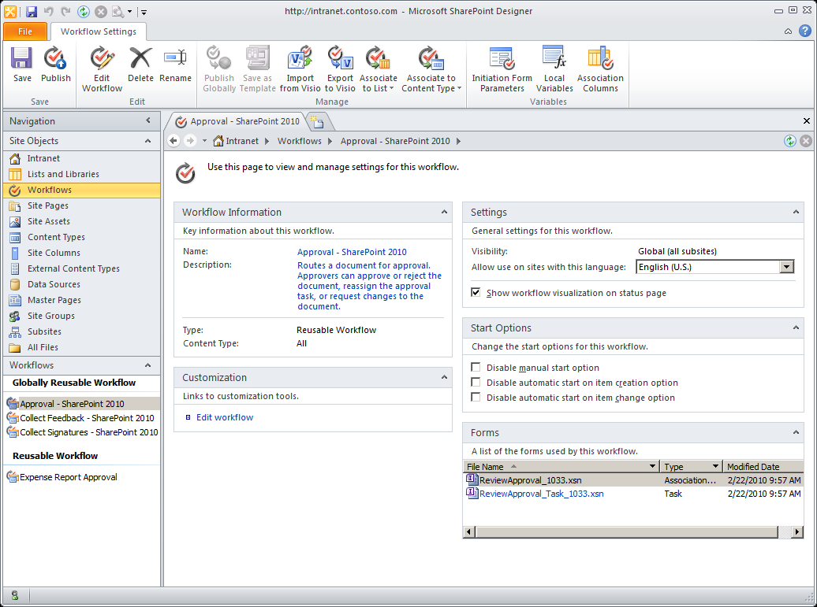
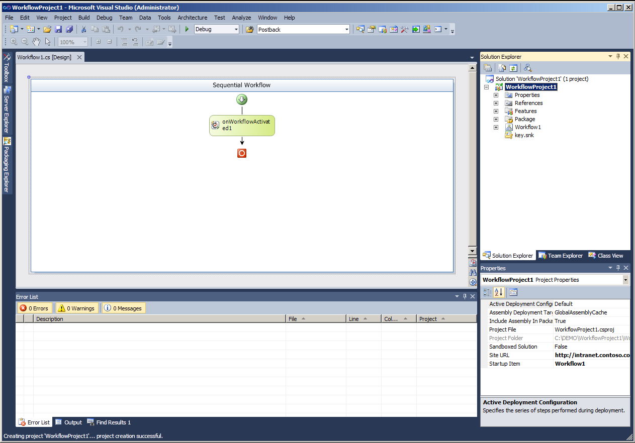
SharePoint Workflow Tools Continuum
Business Analyst/Process Designer
Designer/IW/Power User
Professional developer
Declarative Workflows
Code Workflows
Event Receivers
Custom Activities
Design skeleton workflow processes
View workflow visualizations
.vwi
.wsp
.vwi

Slide 6

Creating Workflows in Visio 2010
Visio has SharePoint Workflow template
Allows you to create workflow design in Visio
Workflow can be exported to SharePoint Designer

Slide 7

Creating Visio Workflows
demo

Slide 8

Designing Workflows in SharePoint designer 2010

Slide 9
SharePoint Designer 2010 Improvements
New declarative workflow designer
New Types of Workflows
New Actions/Activities
Task Process Designer
Visio Visualization
Support for Sandboxed Custom Activities

Slide 10
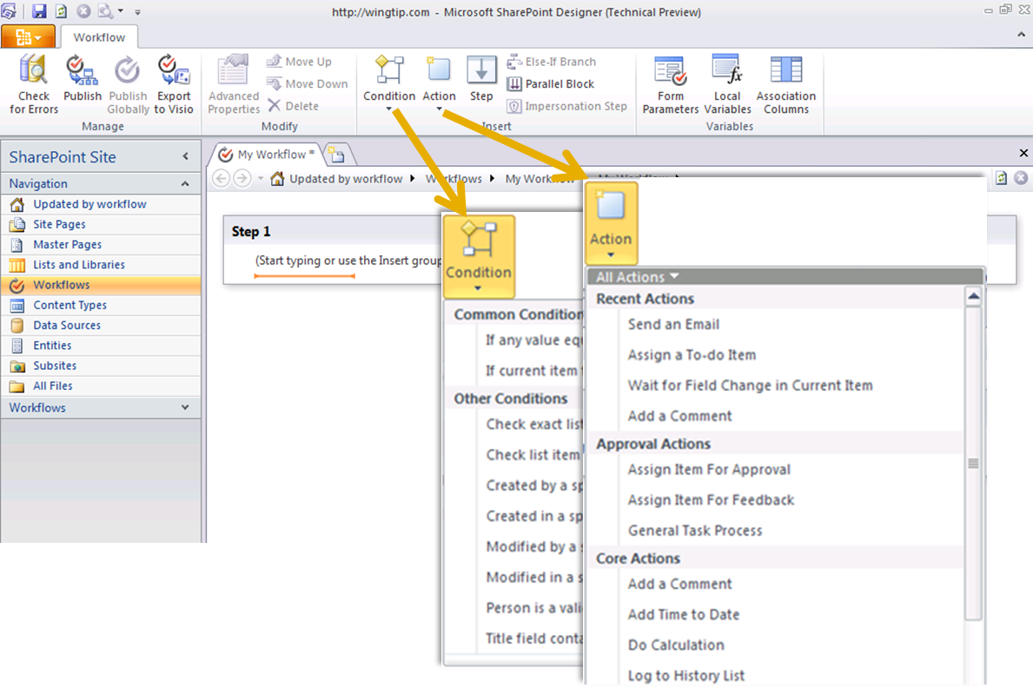
SharePoint Designer Workflows
New “Full Screen” declarative workflow designer

Slide 11
SPD’s Declarative Workflow Designer
Core tooling improvements
Constructs
nested logic
impersonation step
Parallel blocks
Enhanced data binding, on-demand columns
Use new and improved actions
Manager, user profile lookups
Doc set and record management
Read/write to external lists
Import Visio SharePoint Workflows
Solution packaging for portability

Slide 12

Types of Workflows
List Workflow
Associated with a list
Much like MOSS 2007 Workflows
Can be created in SPD 2010
Can be imported/exported from Visio
Reusable Workflow
Can be assigned to content type
Can be exported to .wsp for use in other sites
Can be imported/exported from Visio
Can be created in SPD 2010 & VS2010
Site Workflow
Not bound by a list
Manually Started or via OM
Can be created in SPD 2010 & VS2010

Slide 13
SharePoint Designer OOTB Actions
Core Actions
Send Email, Set WF Status…
Document Set Actions
Send to Repository, Start Approval…
List Actions
Check In/Out Item, Declare Record…
Relational Actions
Lookup Manager of User
Utility Actions
Substring operations, Interval between dates
Task Actions
Start Approval, Assign a To-Do…

Slide 14
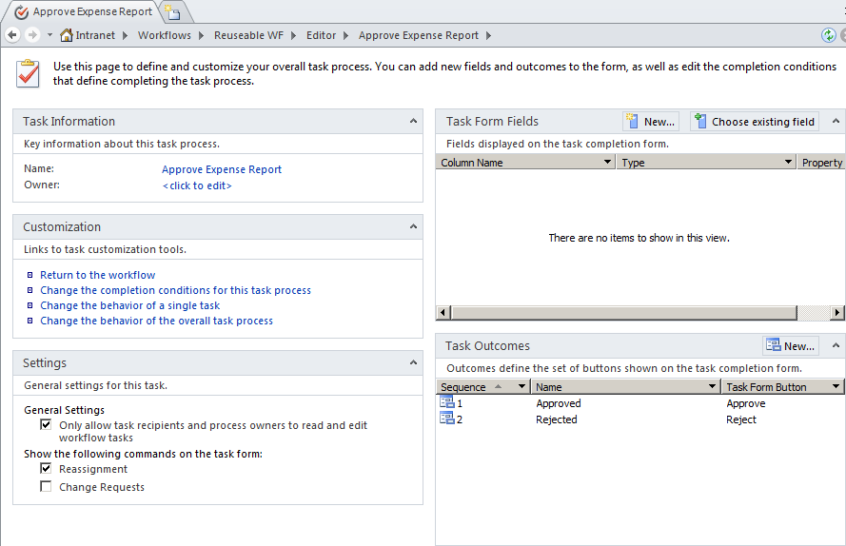
Task Process Designer
View all task information
Customize the whole process, or individual tasks (or both)
Build robust behaviors
“If 50% agree, auto-approve”
“If user is unavailable, escalate to manager”
“If this task wasn’t meant for me, let me reassign it to another user”

Slide 15
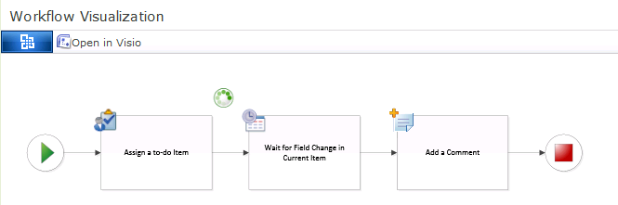
Visio Visualization
Visualize a single workflow instance
Not for aggregation, reporting or auditing
Only for SharePoint Designer

Slide 16
Custom Activities
Plug in your own custom activities
Fully trusted deployment model, or…
Limited functionality when deployed as Sandboxed solution
Or build on top of existing activities
OfficeTask exposed in Visual Studio
Leverage in existing workflows

Slide 17
Creating SharePoint Designer Workflows
demo

Slide 18

Developing Workflows with Visual Studio 2010

Slide 19
What’s new in Visual Studio 2010
Site Workflows
Import Reusable Workflows
ASP.NET Form Templates
Workflow Events
Sandboxed Custom Activities
External Data Exchange Services

Slide 20
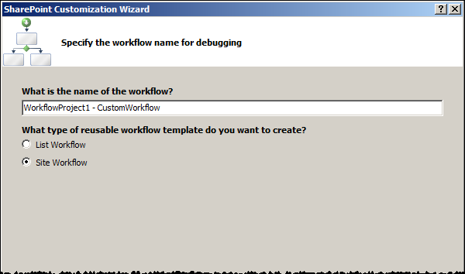
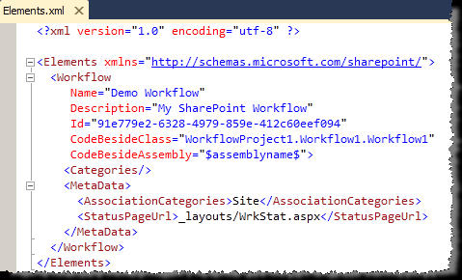
Developing Site Workflows
Site Workflows
List / Item activation properties are null
No auto-start

Slide 21
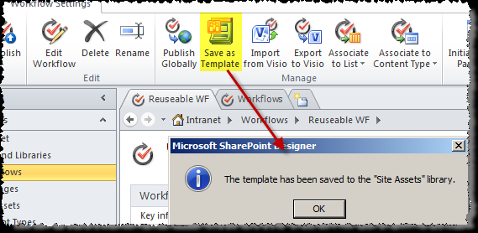
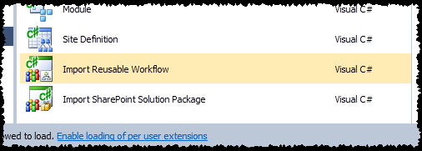
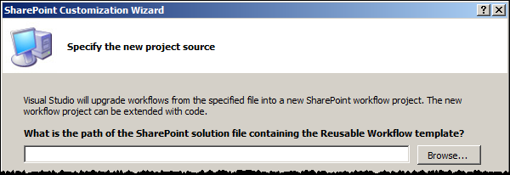
Import Reusable Workflows

Slide 22
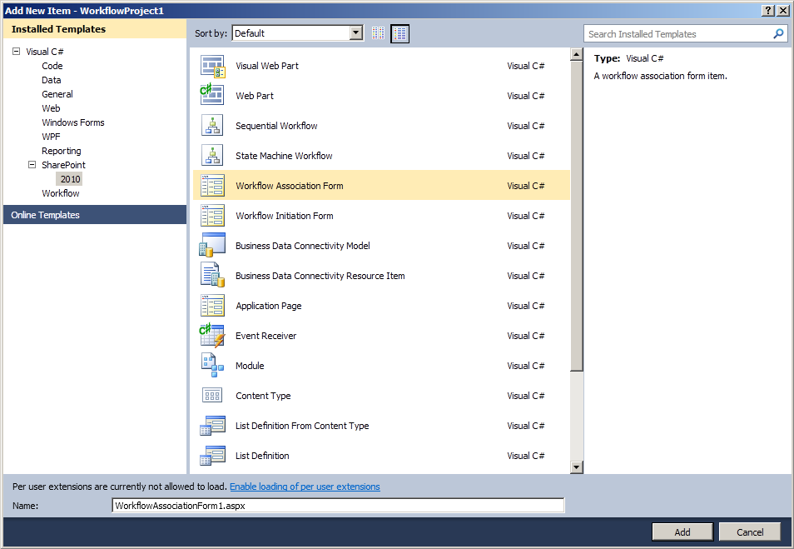
ASP.NET Workflow Form Templates
Generates the required code
Updates the elements.xml file
Available
Association
Initiation

Slide 23
Workflow Event Receivers
Similar to List Event Receivers
Applies to Site, Root Web, Web, List, or List Template scope
Support built into VS 2010 SharePoint Tools
EventReceiver Project or Item Template
Scenarios
Call sub-workflows and wait for completion
Provide more elaborate reporting

Slide 24
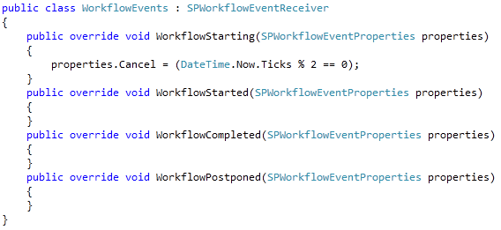
Workflow Event Receivers - Example

Slide 25
Sandboxed Custom Activities
Workflow Actions – Action Element must have SandboxedFunction=True
Does not install .actions file
Upload to Solution Gallery and use from within SPD when that site is accessed
Same rules apply as to all Sandboxed Solutions
Cannot derive from OOTB Activities

Slide 26
Pluggable EDE Services (EDES)
Interact with LOB systems by using custom External Data Exchange services
Requires low-level understanding of WF layer
You can write your own events
No partial trust

Slide 27

Flow of Events
SharePoint
Workflow Instance
Runtime
Local Service
Web Service
Process Order

Slide 28
Developing Workflows with Visual Studio 2010
demo

Slide 29
Summary
What’s New in SharePoint 2010 Workflow
Creating Workflows in Visio 2010
Designing Workflows with SPD
Developing Workflows with VS 2010

Slide 30


Slide 31

© 2010 Microsoft Corporation. All rights reserved. Microsoft, Windows, Windows Vista and other product names are or may be registered trademarks and/or trademarks in the U.S. and/or other countries.
The information herein is for informational purposes only and represents the current view of Microsoft Corporation as of the date of this presentation. Because Microsoft must respond to changing market conditions, it should not be interpreted to be a commitment on the part of Microsoft, and Microsoft cannot guarantee the accuracy of any information provided after the date of this presentation. MICROSOFT MAKES NO WARRANTIES, EXPRESS, IMPLIED OR STATUTORY, AS TO THE INFORMATION IN THIS PRESENTATION.

